Slide 1
Introduction to Bioinformatics
Chaochih Liu
Li Lei
September 20, 2017

Slide 2
Robust research
Reproducible research
Notes:
LL

Slide 3
Why do we need robust research?
Produce huge intermediate data files
No one tool fits all organisms
Notes:
CL
Difficulty sifting through large amounts of intermediate data
Tools are typically developed on a single organism and uses a specific organism as the training set
Be wary of silent errors
Example: LD analysis filtering out columns that were completely empty (filled with “NA” values)
Package function converts genotype format AA to A/A
Function also converted NA to N/A
Wasn’t filtering out NA’s b/c it had been converted to N/A

Slide 4
Never trust your tools (or data)!
Notes:
CL

Slide 5
Q & A?
How do you check if your wet lab experiment works?
e.g., PCR products are expected?
Courtesy from https://www.yourgenome.org/facts/what-is-gel-electrophoresis
Notes:
LL

Slide 6
How to check if the output produced by your tools is correct?
Randomly pick several data points
Let code test code
Notes:
LL

Slide 7
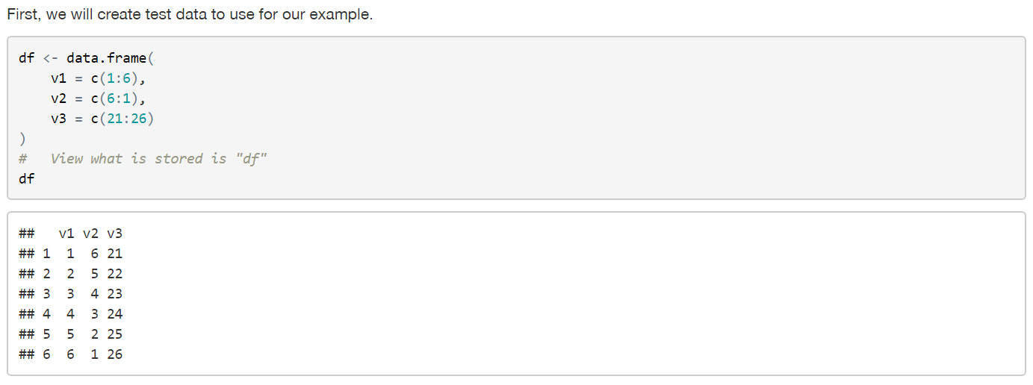
Example: check output produced is correct
Notes:
CL

Slide 8
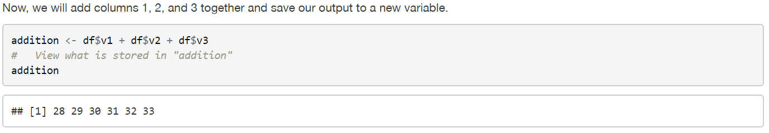
Example: check output produced is correct
Notes:
CL

Slide 9
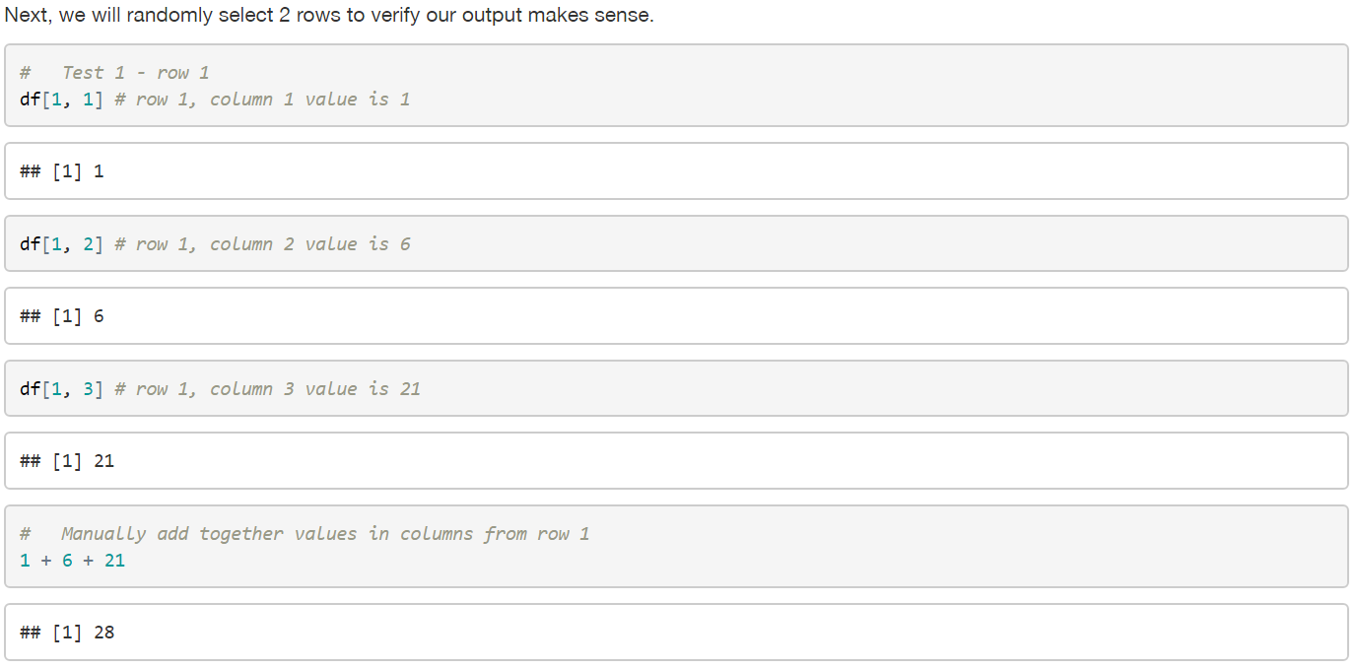
Example: check output produced is correct
Notes:
CL

Slide 10
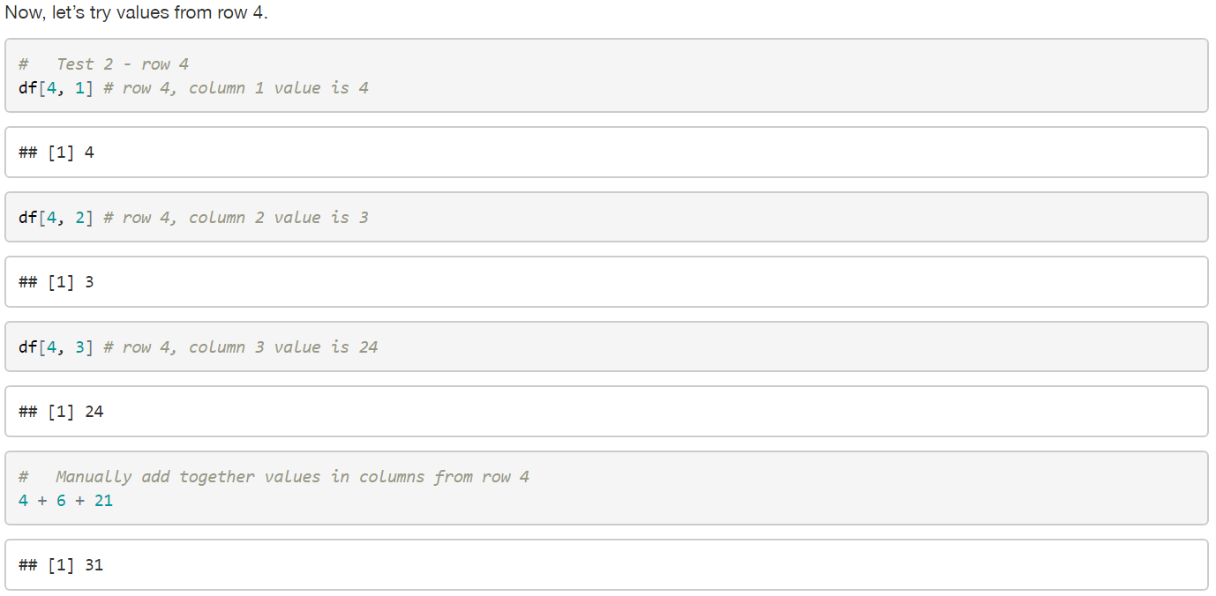
Example: check output produced is correct
Notes:
CL

Slide 11
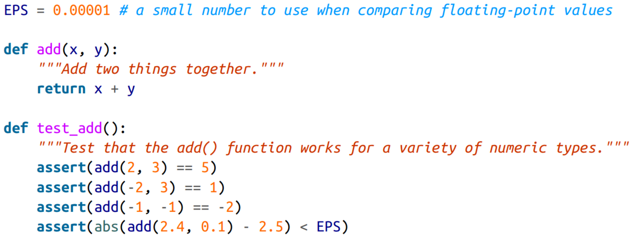
Unit testing
Notes:
LL

Slide 12
Let your computer do the work for you!
Notes:
CL

Slide 13
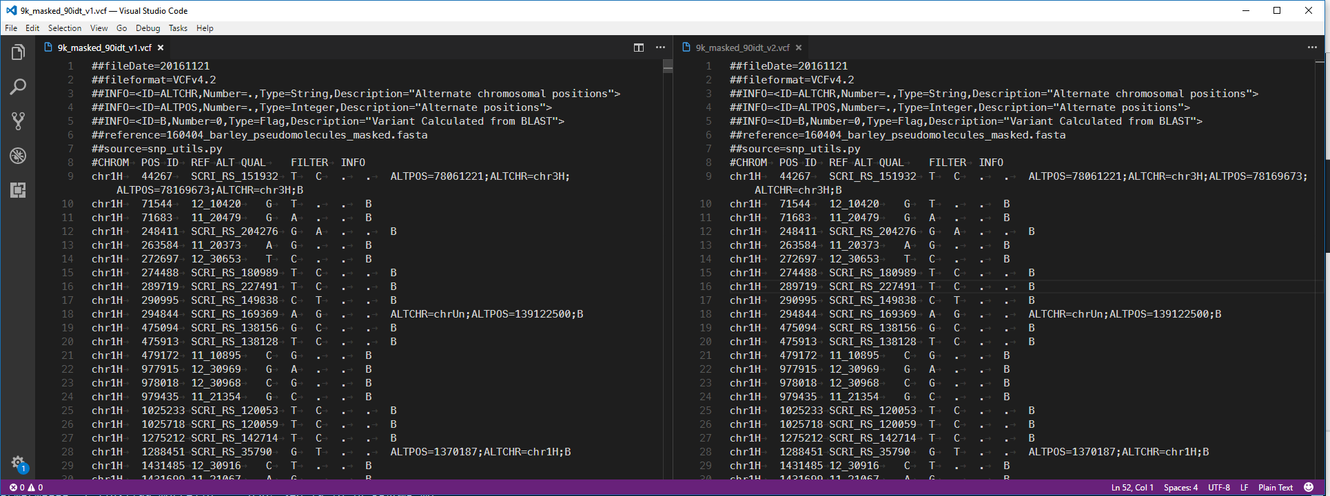
Example: Let your computer do the work for you!
It’s been a year and we have 2 versions of a VCF file
No notes or README file available
How do we figure out if these files are the same? Different? Which one to use?
Notes:
CL: Briefly explain what a VCF file is
VCF is tab delimited and has following parts:
metadata header starting with ##
header with 8 mandatory fields and genotypes (if called)
data lines with info for variant at particular position and genotypes for this individual

Slide 14
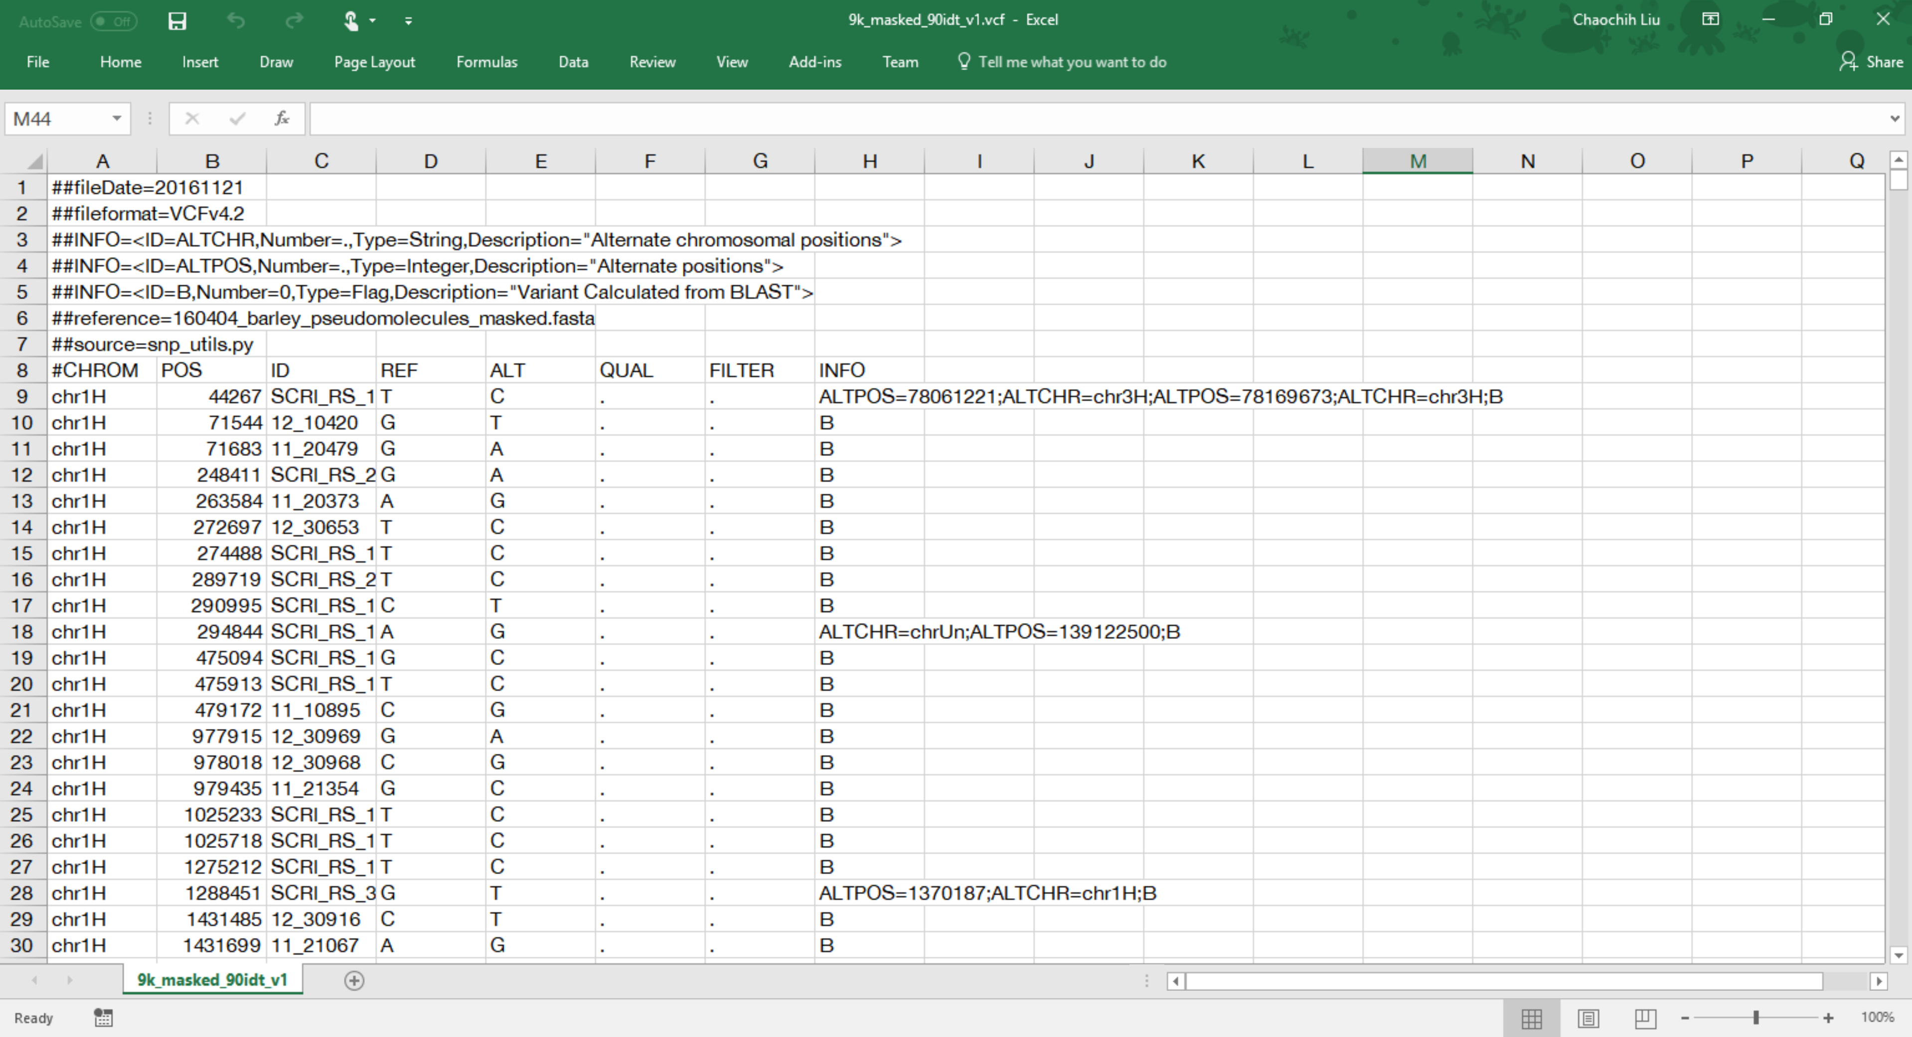
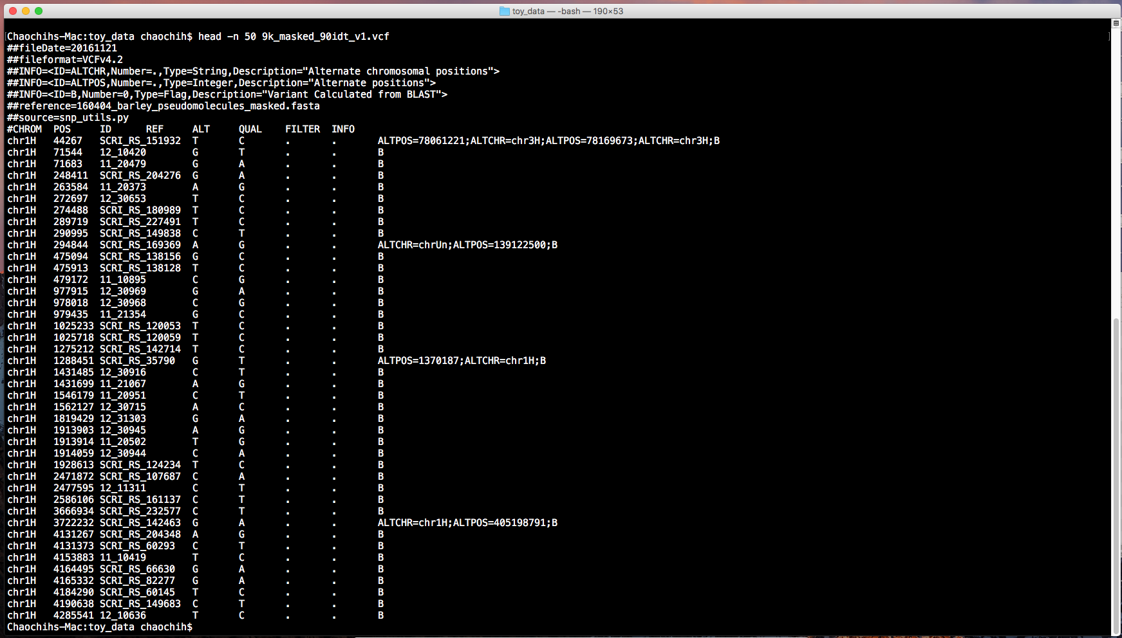
Example: Let your computer do the work for you!
How do we figure out if these files are the same? Different? Which one to use?
Note: VCF file is over 2000 lines long
Could try to manually compare the 2 files
Could try to use Microsoft Excel
Could use Unix/Linux command line
Notes:
CL:

Slide 15
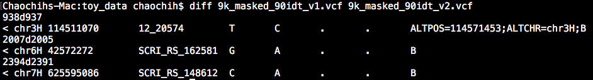
Example: Let your computer do the work for you!
How do we figure out if these files are the same? Different? Which one to use?
Using Unix/Linux command line:
Notes:
CL: There are 3 differences between 2 VCF files

Slide 16
Why should research be reproducible?
Public investment requires reliable results
Research training is NOT intended to teach a boutique set of skills only an artisan can replicate
Work is replicated and updated
Notes:
LL

Slide 17

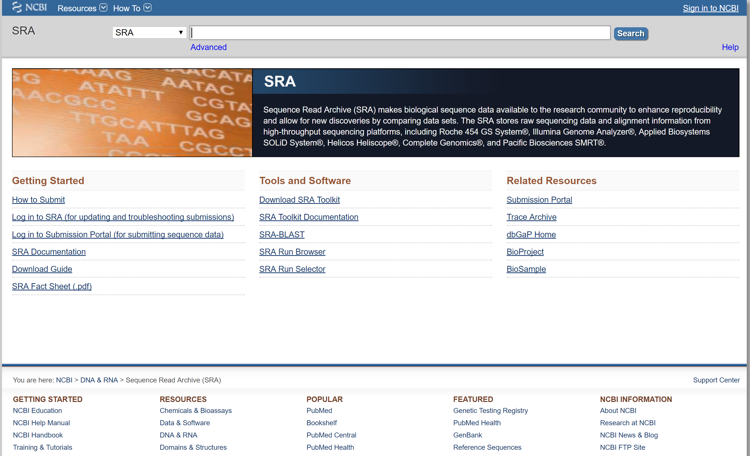

How to do reproducible research?
Notes:
LL: Release your code and data

Slide 18

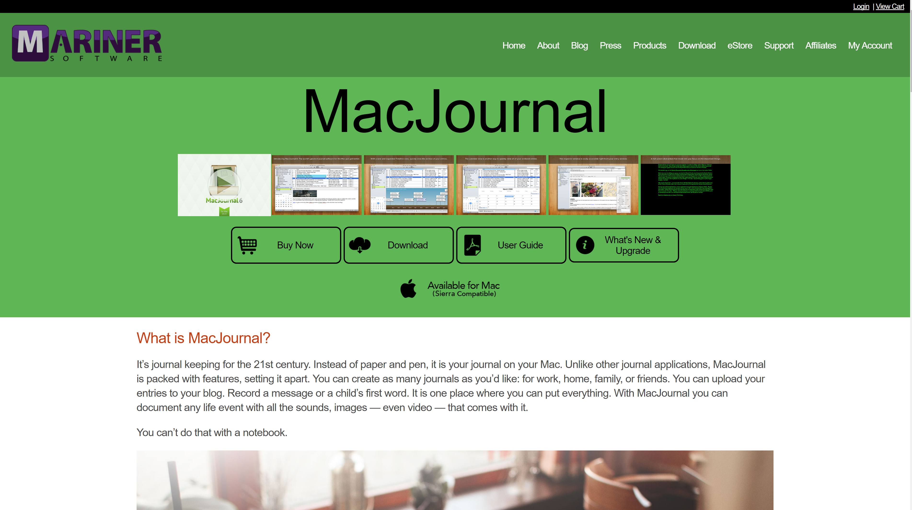
Document everything
Notes
Digital notebook for analyses
README file
plain text-future proof format
Markdown
Notes:
LL

Slide 19
What do we mean by document everything?
Your methods and workflow
The origin of the data
When you download your data
Data version
How you downloaded the data
The version of the software that you ran
Notes:
LL

Slide 20
Organize your directory/repository
Q/A? Think pair shared
Notes:
LL

Slide 21
Example project directory
Analysis
01
Script
02
Data
03
Results
04
Manuscript
05
Notes:
CL

Slide 22
File naming
Use only letters, numbers, underscores, and dashes
Use meaningful file names
Avoid using filenames such as:
file1.txt
plot1.txt
my_file.txt
Notes:
CL

Slide 23
Group activity
What are 3-4 essential components to include in a file name?
for raw data
for figures
for scripts
for results
for intermediate and final output data
Notes:
CL
for raw data: samples name, file extension, date, additional indicators of the single end/paired end reads
for figures: type of plots, file extension, word describing type of plots, maybe include the analysis name
for scripts: purpose of the script, file extension
for results: analysis name/ abbreviation, sample/sample group name, maybe add the date
for intermediate and final output data: word indicator of analysis stage, sample name, abbreviation of the project?

Slide 24
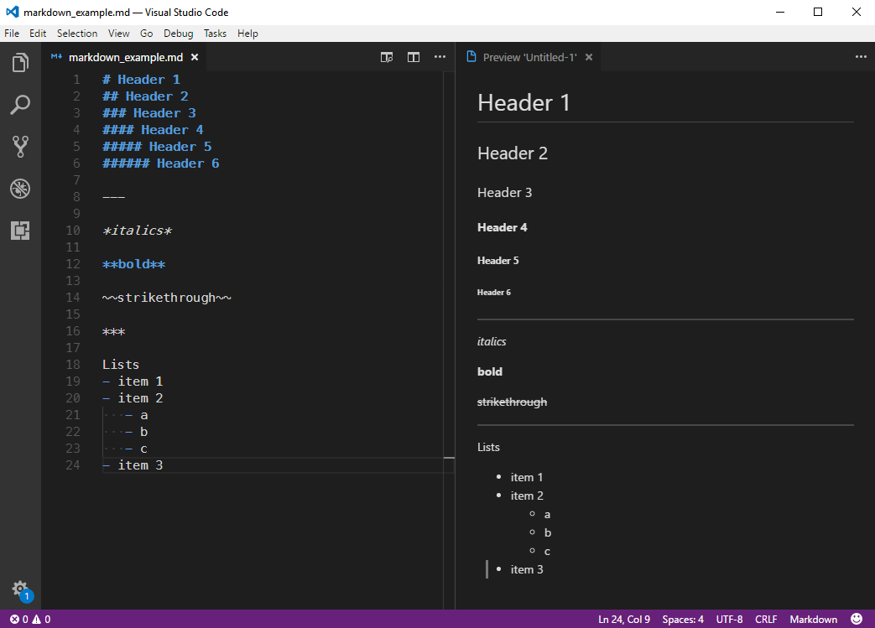
Markdown
Notes:
CL: depend on time
Markdown
lightweight markup language with plain text formatting syntax
easy to read in raw form
easy to create using any text editor
designed so that it can easily be converted into HTML
often used to format README files

Slide 25
Shell tricks
shell expansion
*
{}
[]
$ echo dog-{gone,bowl,bark}
$ mkdir –p zmays-snps
$ mkdir –p zmays-snps/{data,script,analysis}
Notes:
CL

Slide 26
Shell tricks
shell expansion
*
{}
[]
$ ls *R2.fastq
$ ls zmays{A,B,C}_R{1,2}.fastq
Notes:
CL

Slide 27
Shell tricks
shell expansion
*
{}
[]
$ ls zmays[AB]_R1.fastq
Notes:
CL

